Slide 1

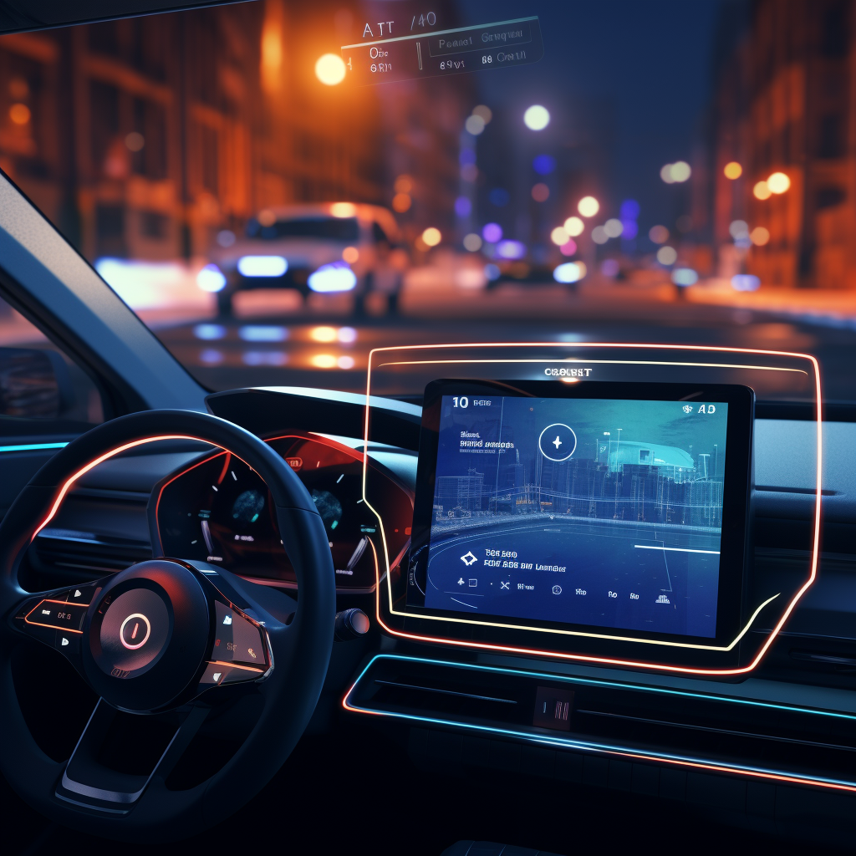
Enable Blind LLMs with Vision
Visionary Co-Driver: LLMs Enhance Driver Perception of Potential Risks with AR-HUD
---My Summer Research Summary
王杰，04/06/2024
Advisor: 向为教授 Prof. Wei Xiang
Mentor: 黄莹莹 Yingying Huang
Github: Summer_Research_2023
Notes:
我们为什么做这个工作，我们做这个工作有什么价值，架构逻辑要更清楚

Slide 2

Content
Visionary Co-Driver: LLMs Enhance Driver Perception of Potential Risks with AR-HUD
Project Intuition
Model Selection
System Design
User Study
Failure and Success
Research Reflection

Slide 3
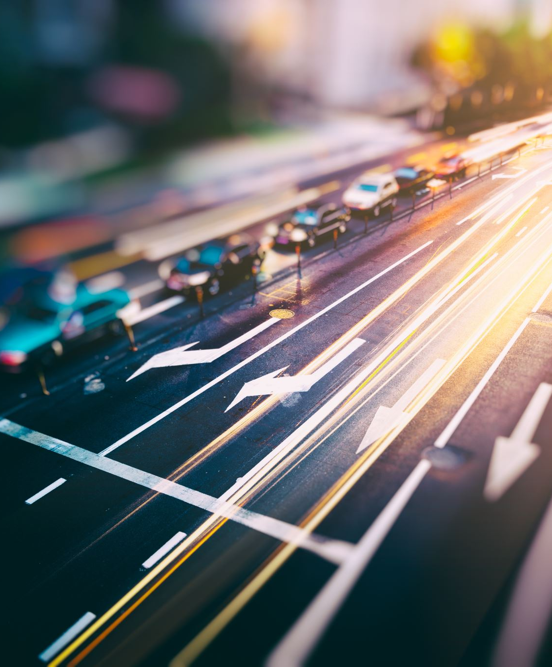
Intuition: Corner cases are countless, but LLM has logic
Visionary Co-Driver
Road scene understanding is a relative complex and important topic in autonomous driving field.
Traditional approach like driving risk field or object detection is useful and practical, but they can’t cover all the possibilities in the real-world scenario (Too much annoying if-statements).
Solving it in a brand-new way is my intuitive study interest, because I saw the potential capability within LLM to be a co-pilot, helping drivers to recognize and avoid those potential risk.

Slide 4
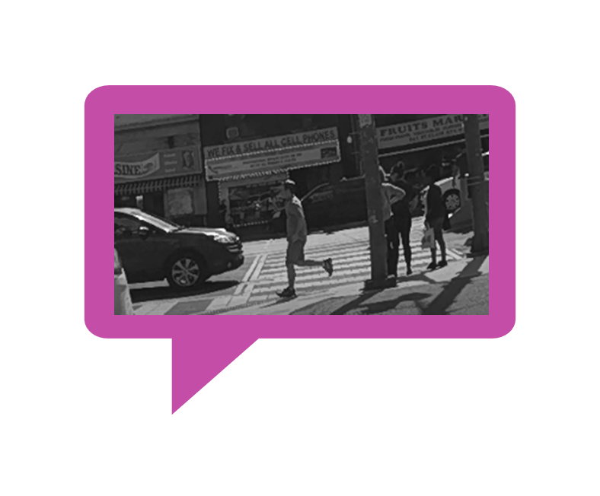

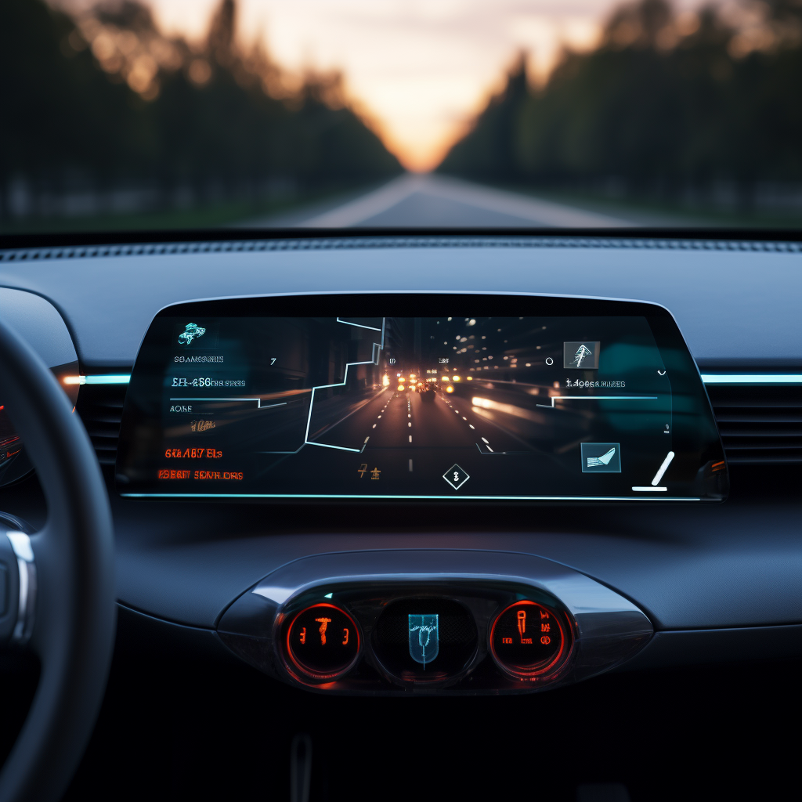
However, there is a huge gap between logic and reality: modality difference
Visionary Co-Driver
“有啥子在我前头啊？看不着啊”
The ChatGPT can 'think 'through text conversation, but it doesn’t have internal capability of perception.
Therefore, we need to provide a tool for it to "read" the road (Road Scene Understanding).

Slide 5
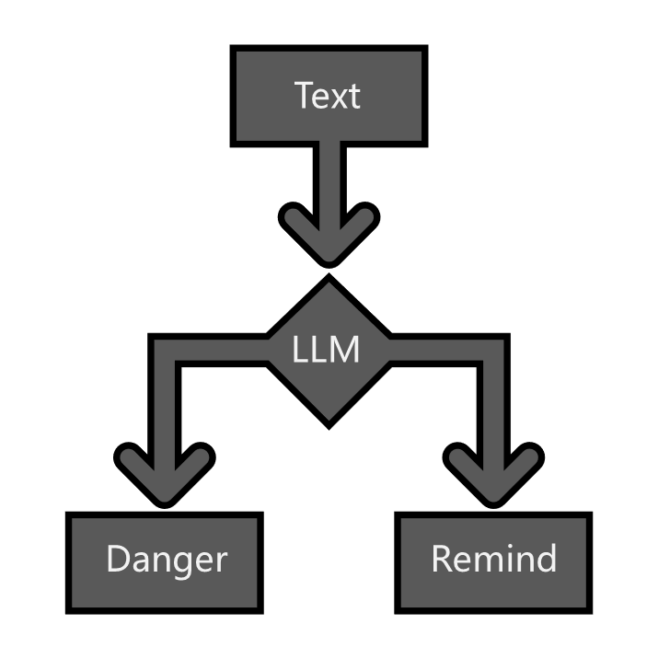
Our solution: combine SOTA models together, obtain on-road information
Visionary Co-Driver
A vision2text cascaded connected model, helping the LLM to detect the road

Slide 6
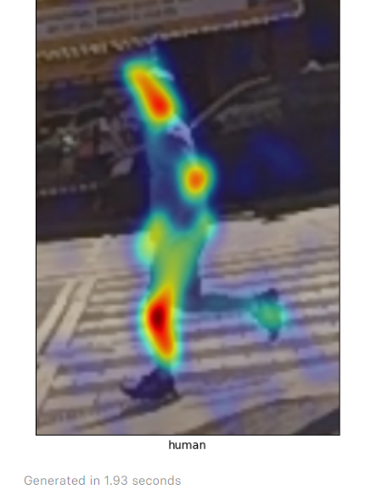
What is the Vision Feature of a pedestrian?
Visionary Co-Driver
Location: road or sidewalk? Left or right side?
Distance: near or far from us?
Speed: fast or slow?
Type: old or young?

Slide 7
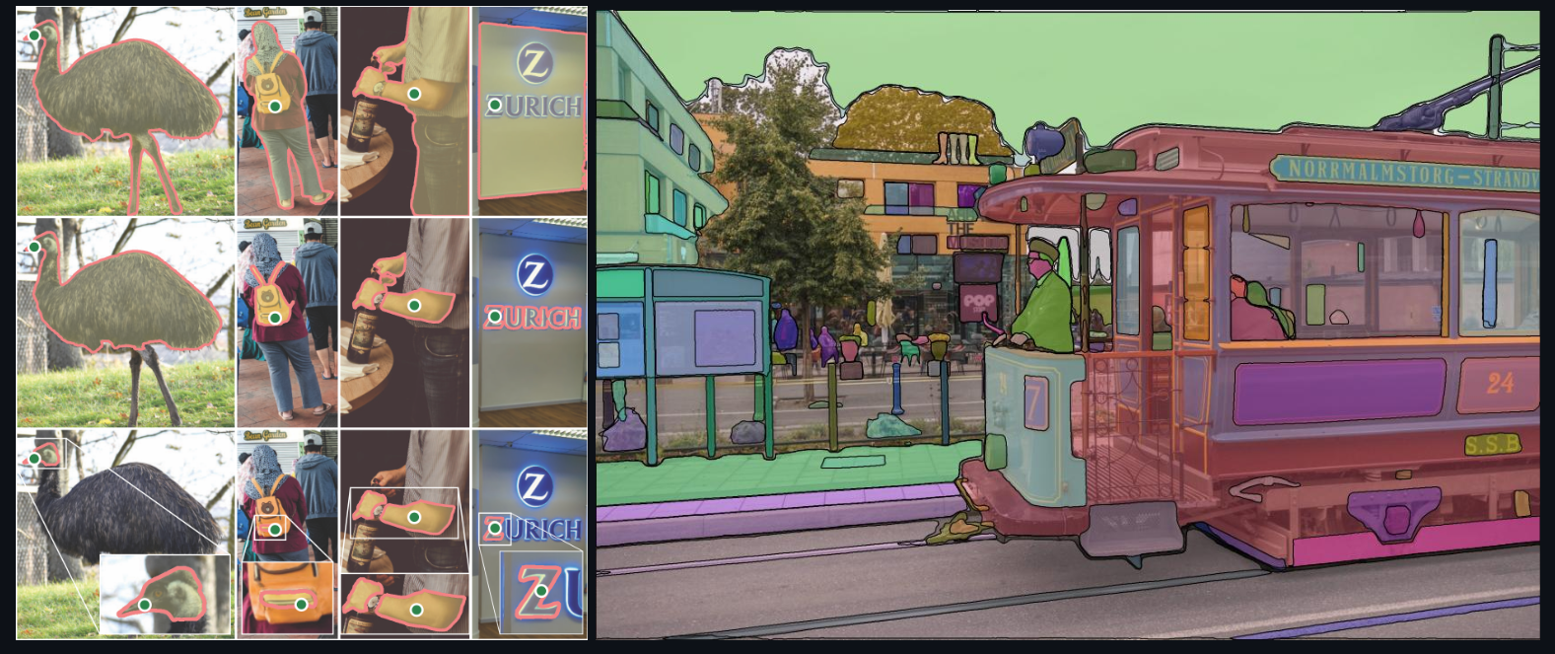
Segmentation: Segment Anything(SAM)
Visionary Co-Driver
- [2023SOTA]
- Transformer based unlabeled segmentation, SOTA zero-shot segmentation

Slide 8
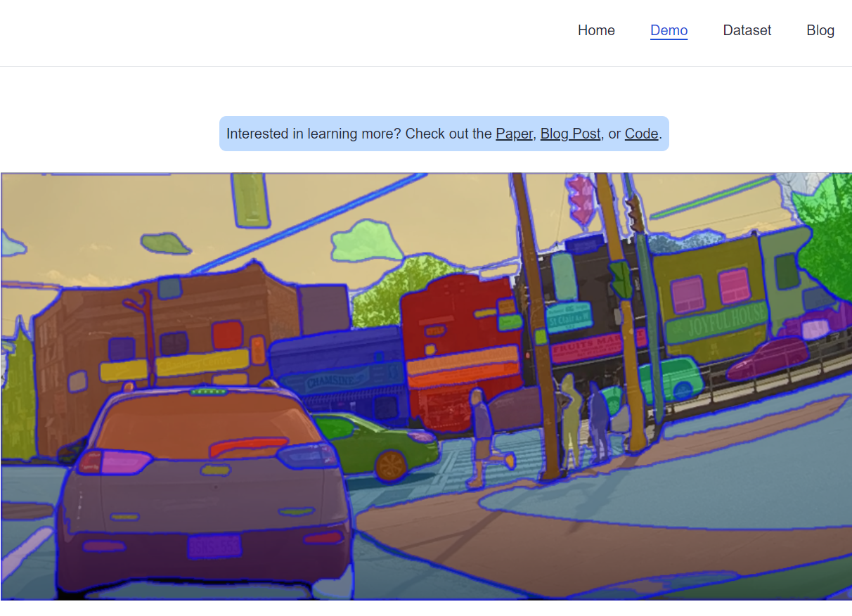
Divide the sidewalk from road
Visionary Co-Driver
After segment everything, it’s clear that all the sidewalks are shown in the image.

Slide 9
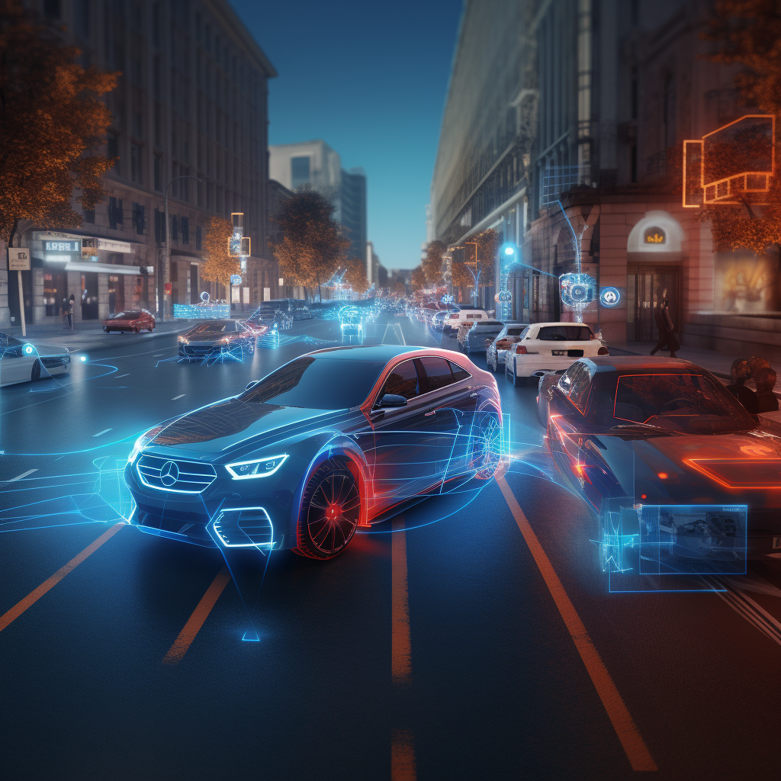
But segment everything is expensive!
Visionary Co-Driver
How can we obtain the mask information easily from SAM?

Slide 10
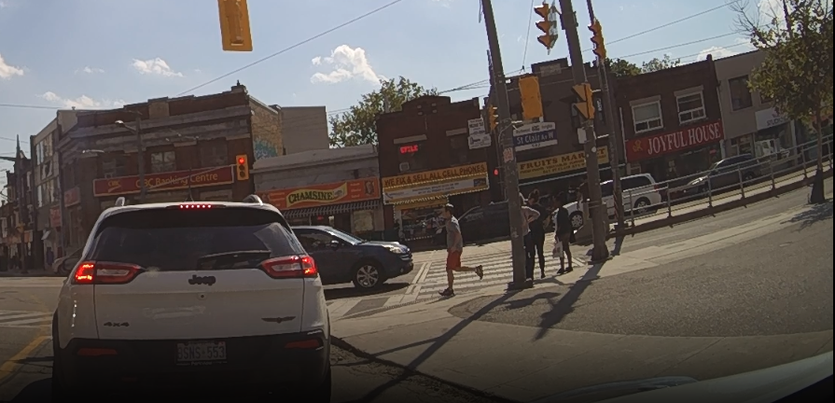
Take a review on SAM:
Visionary Co-Driver
- can generate pixel level binary mask of the image
- Can be prompted by both point and box, including positive and negative prompt

Slide 11
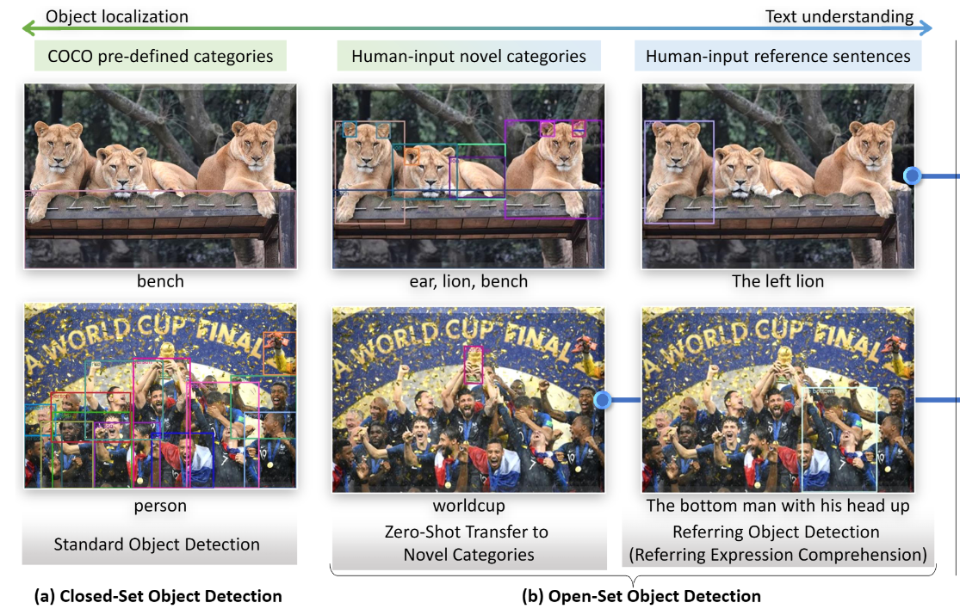
Object detection: Grounding DINO
Visionary Co-Driver
- [2022SOTA]
- Transformer based knowledge distillation, SOTA zero-shot detection.
- can generate bbox of the detected object using monocular image

Slide 12
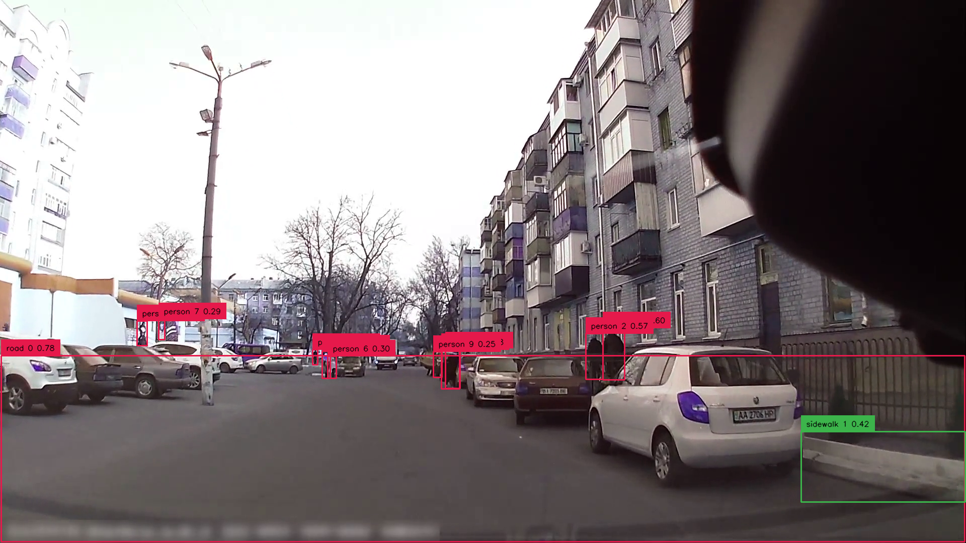
Visionary Co-Driver
Object detection: Grounding DINO
- Can be prompted based on nature language
- The gDINO can successfully recoginze the road & sidewalk using contrast prompting
- Pedestrian detection is separate, optimizing the accuracy

Slide 13
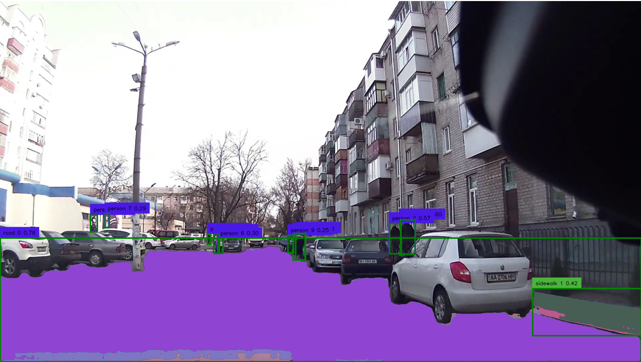
Take a review on SAM:
Visionary Co-Driver
Combining with Grounding DINO, then we realize a SOTA semantic segmentation model

Slide 14
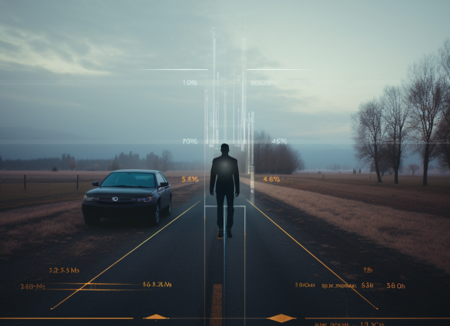
Now, how can we know the distance from pedestrian to us?
Visionary Co-Driver
In industry practice: Radar & Lidar Sensor!
But: we are poor, and we only have monocular video…

Slide 15
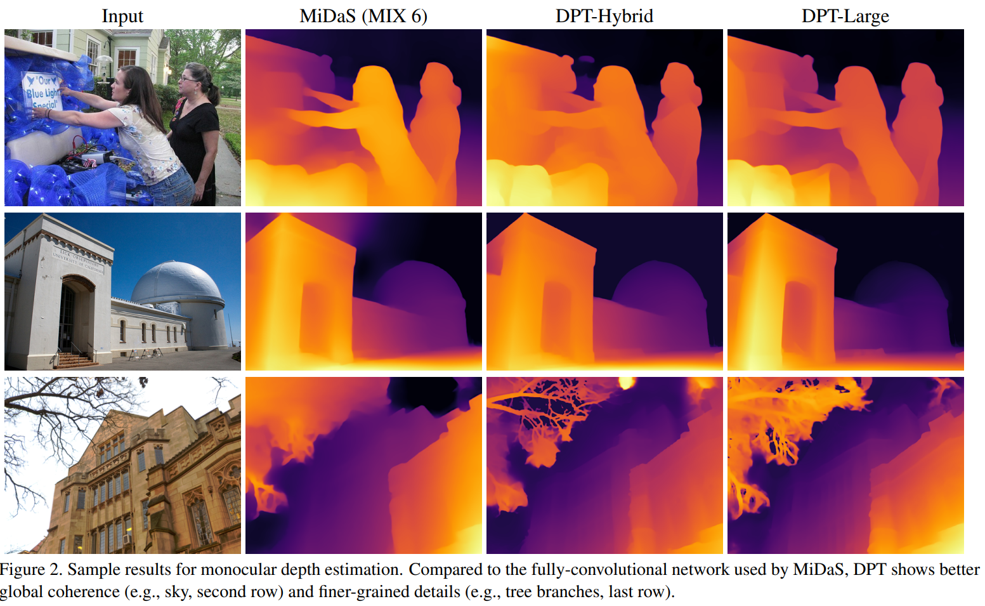
Depth estimation: Dense Prediction Transformer(DPT)
Visionary Co-Driver
- [2021SOTA]
- Transformer based monocular depth estimation
- can generate image-size NumPy array indicating the depth value of each pixel
- Based on it, we obtained the estimated distance from dashcam to object
Output: [very close, close, medium, far, very far]

Slide 16

Depth estimation: Dense Prediction Transformer(DPT)
Visionary Co-Driver
- [2021SOTA]
- Transformer based monocular depth estimation
- can generate image-size NumPy array indicating the depth value of each pixel
- Based on it, we obtained the estimated distance from dashcam to object
Output: [very close, close, medium, far, very far]

Slide 17

LLM: gpt3.5_turbo_16k
Visionary Co-Driver
- long memory, can analyze the road scene with appropriate prompting
output can be seen here (0728 version):
Summer_Research_2023/Blind_LLM_Guide_Project/Chatbot/
There was no long-context or RAG for long video.

Slide 18
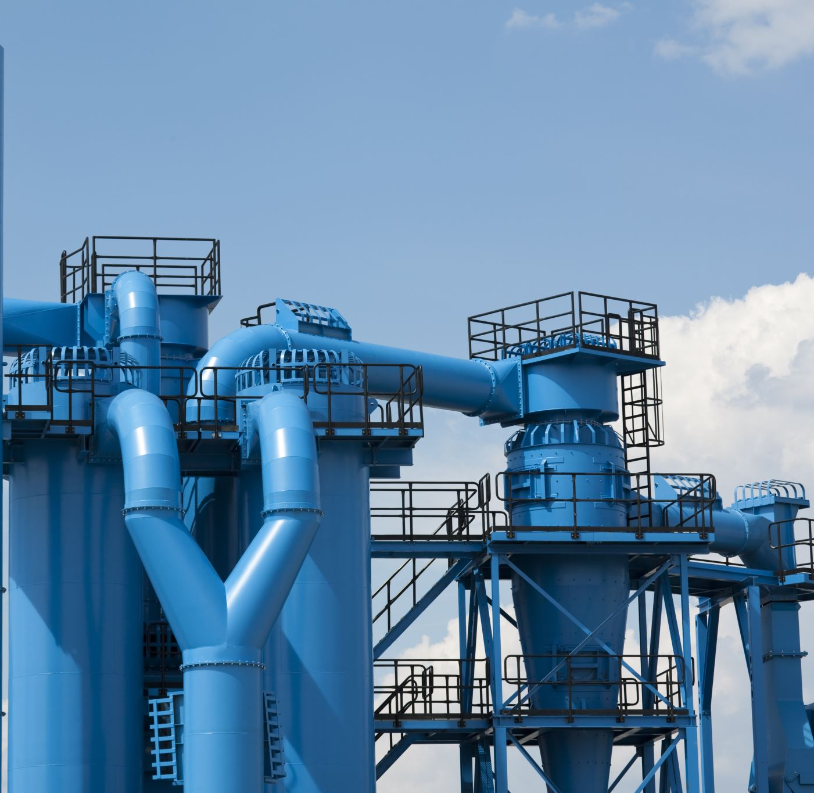
SYSTEM Design
Visionary Co-Driver
So, how do we connect those modal together into a pipeline?

Slide 19
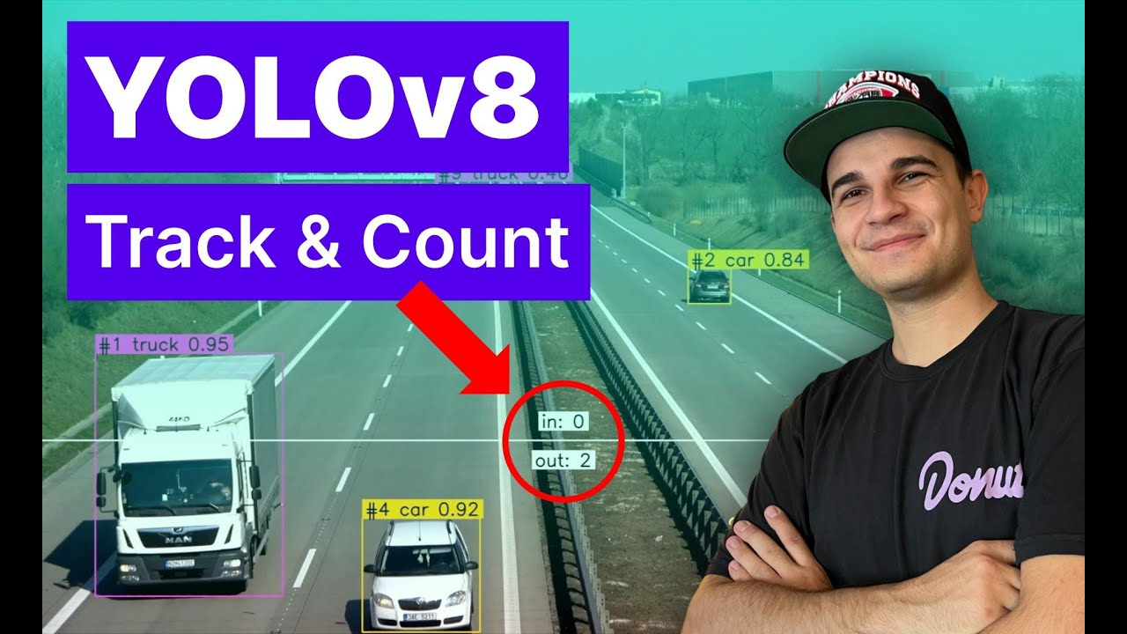
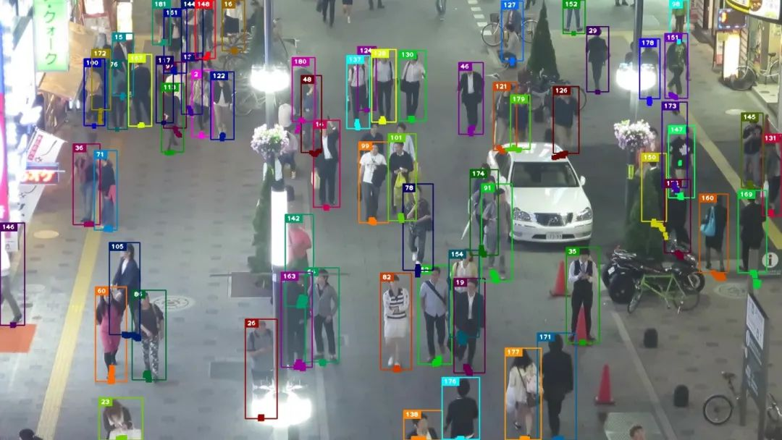
Multiple Object Tracking Yolov8+ByteTrack
Visionary Co-Driver
[2023 SOTA]
Official Support of the classic and powerful real-time CV: You Only Look Once
Fastest with GPU acceleration

Slide 20
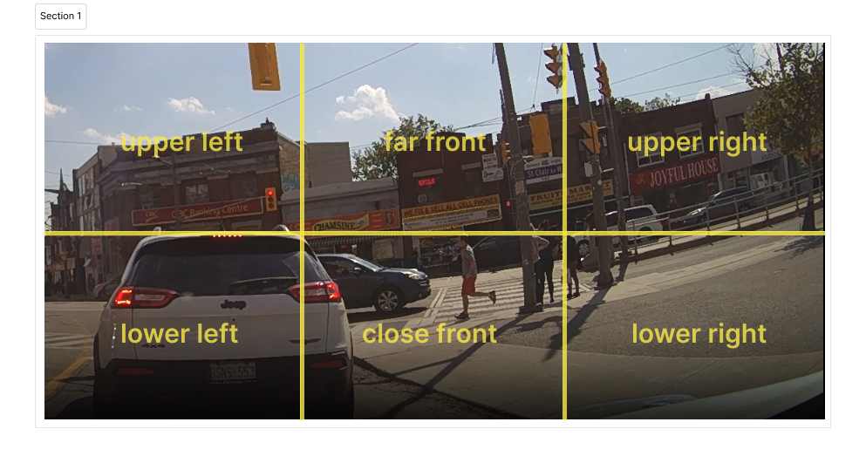
How to use LLM locate potential risk? --- Output format
Visionary Co-Driver
According to early test on LLM’s capability, it can evaluate the danger level and potential risk within the current driving scenario:
Pixel level classification, divide into 6 aspects

Slide 21
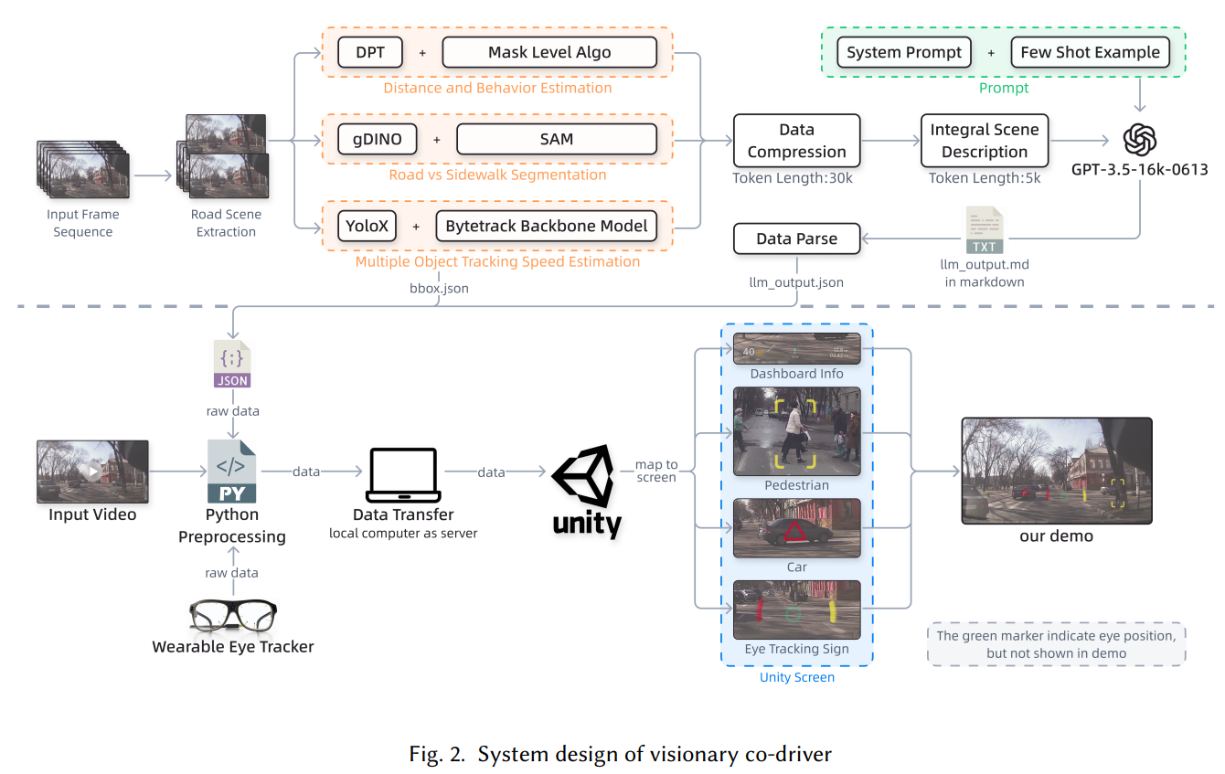
How to use LLM locate potential risk? --- Output format
Visionary Co-Driver
Our solution: 关键帧+混合帧分析
Furthermore, how can we demonstrate it in: - Vision: ARHUD
- Unity enhanced Video
Notes:
输出要说清楚，怎么交代给

Slide 22
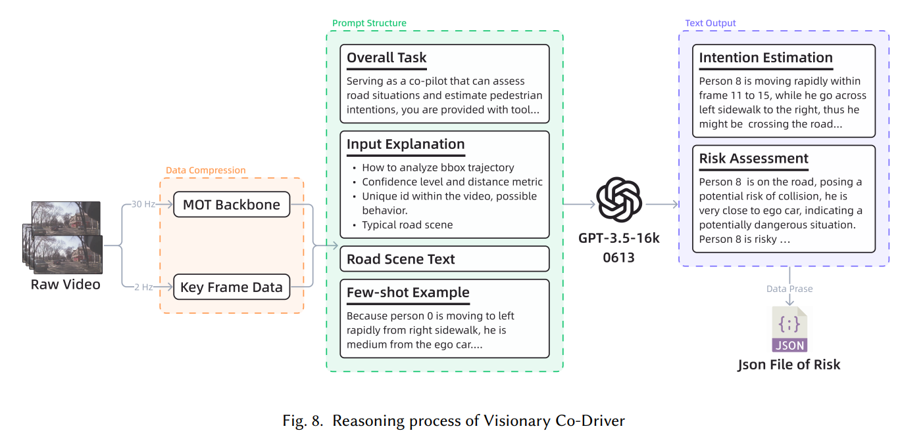
Vision2text
Visionary Co-Driver
Text generation process

Slide 23
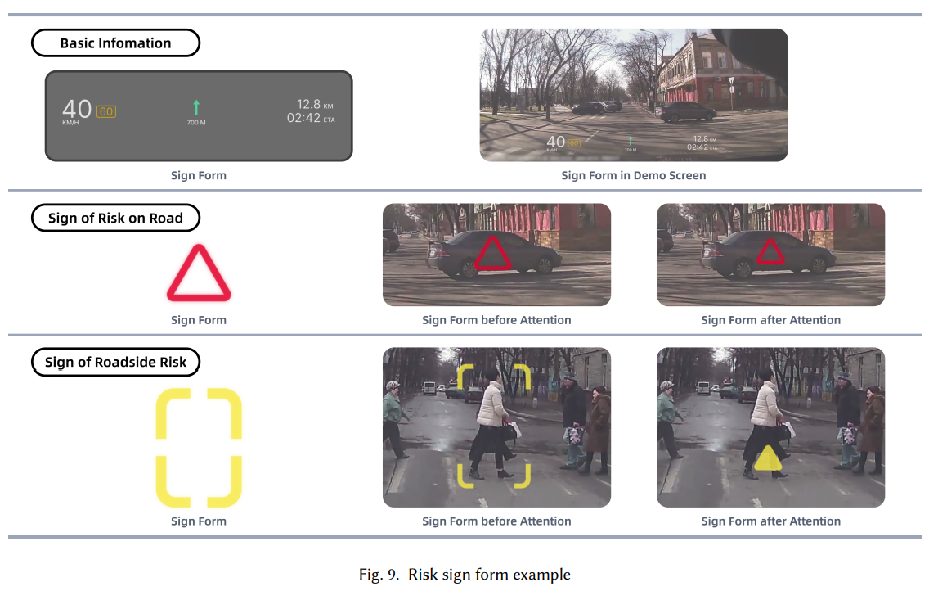
ARHUD
Visionary Co-Driver
Augmented Reality Heads-Up Display (AR-HUD) interfaces

Slide 24
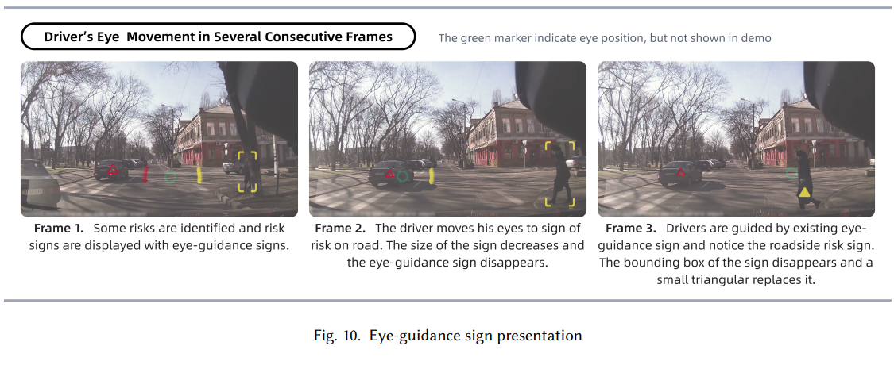
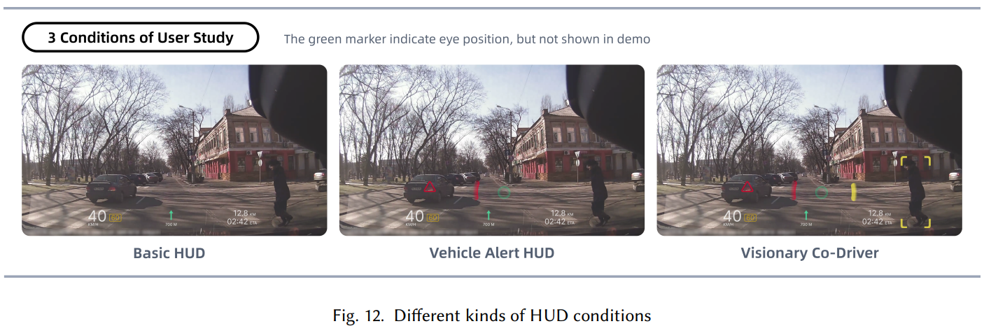
ARHUD
Visionary Co-Driver
Augmented Reality Heads-Up Display (AR-HUD) interfaces

Slide 25
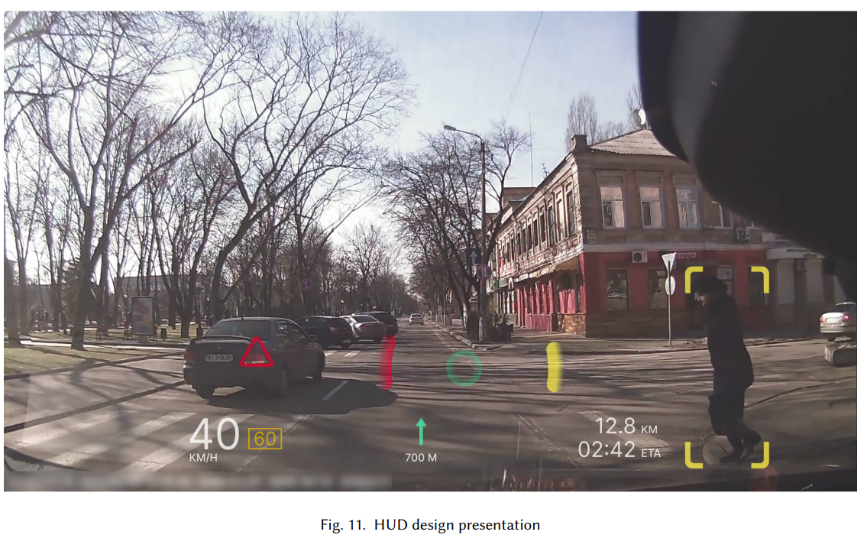
ARHUD
Visionary Co-Driver
Augmented Reality Heads-Up Display (AR-HUD) interfaces

Slide 26
Another basic problem: how to test the model?
Visionary Co-Driver
It occupies a lot of time to do simulation and real-life testing So, we choose video, - monocular - ground truth justification - many pedestrian

Slide 27
JAAD dataset --- the video dataset for pedestrian intention prediction
Visionary Co-Driver
What is JAAD? Joint Attention in Autonomous Driving (JAAD) Dataset.
Purpose: Developed to study pedestrian behavior, interactions, and visual cues in the context of autonomous driving.
Content:
Videos: Over 240 high-resolution video clips from different urban locations.
Annotations: Includes detailed annotations for pedestrians, such as age, gender, actions, and signals.
Scene Information: Traffic conditions, weather, lighting, etc.
Attention and Intention: Captures the complex interplay of pedestrian attention and intention.
Applications: Crucial for training models to recognize pedestrian actions, enhance traffic safety, and facilitate the development of advanced driver-assistance systems (ADAS).
Challenges: Addresses the need for fine-grained analysis, such as recognizing subtle cues from pedestrians.
Website: Link to JAAD Dataset
Notes:
后置，不是自己研究的时间顺序，而是论文的逻辑实现技术

Slide 28
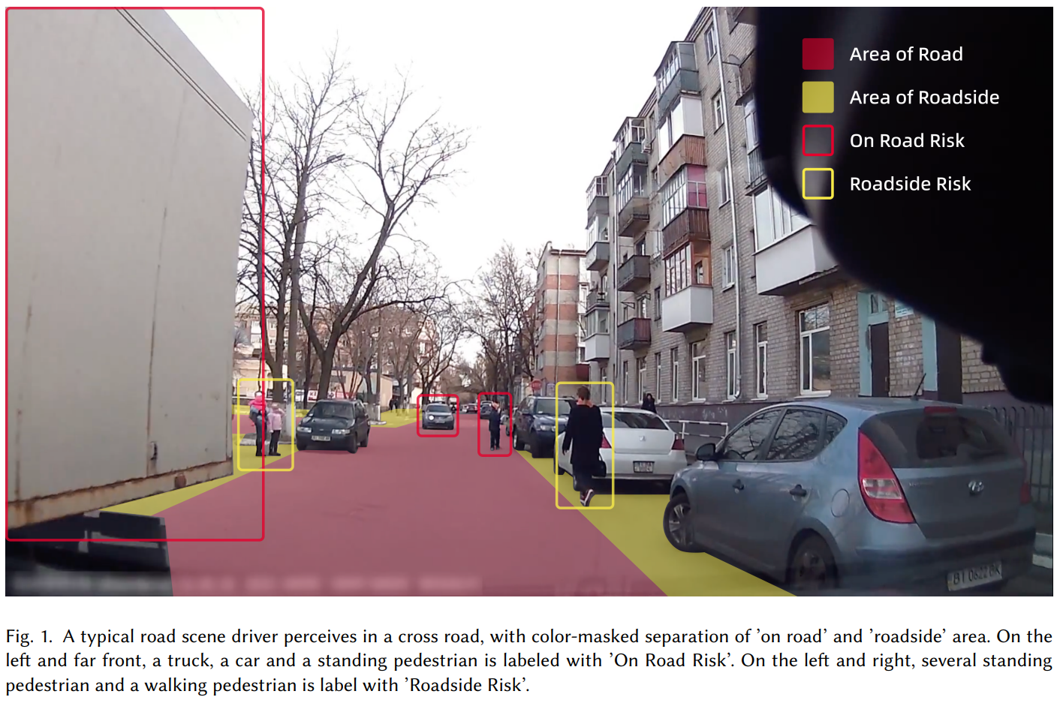
JAAD dataset --- the video dataset for pedestrian intention prediction
Visionary Co-Driver
Notes:
后置，不是自己研究的时间顺序，而是论文的逻辑实现技术

Slide 29
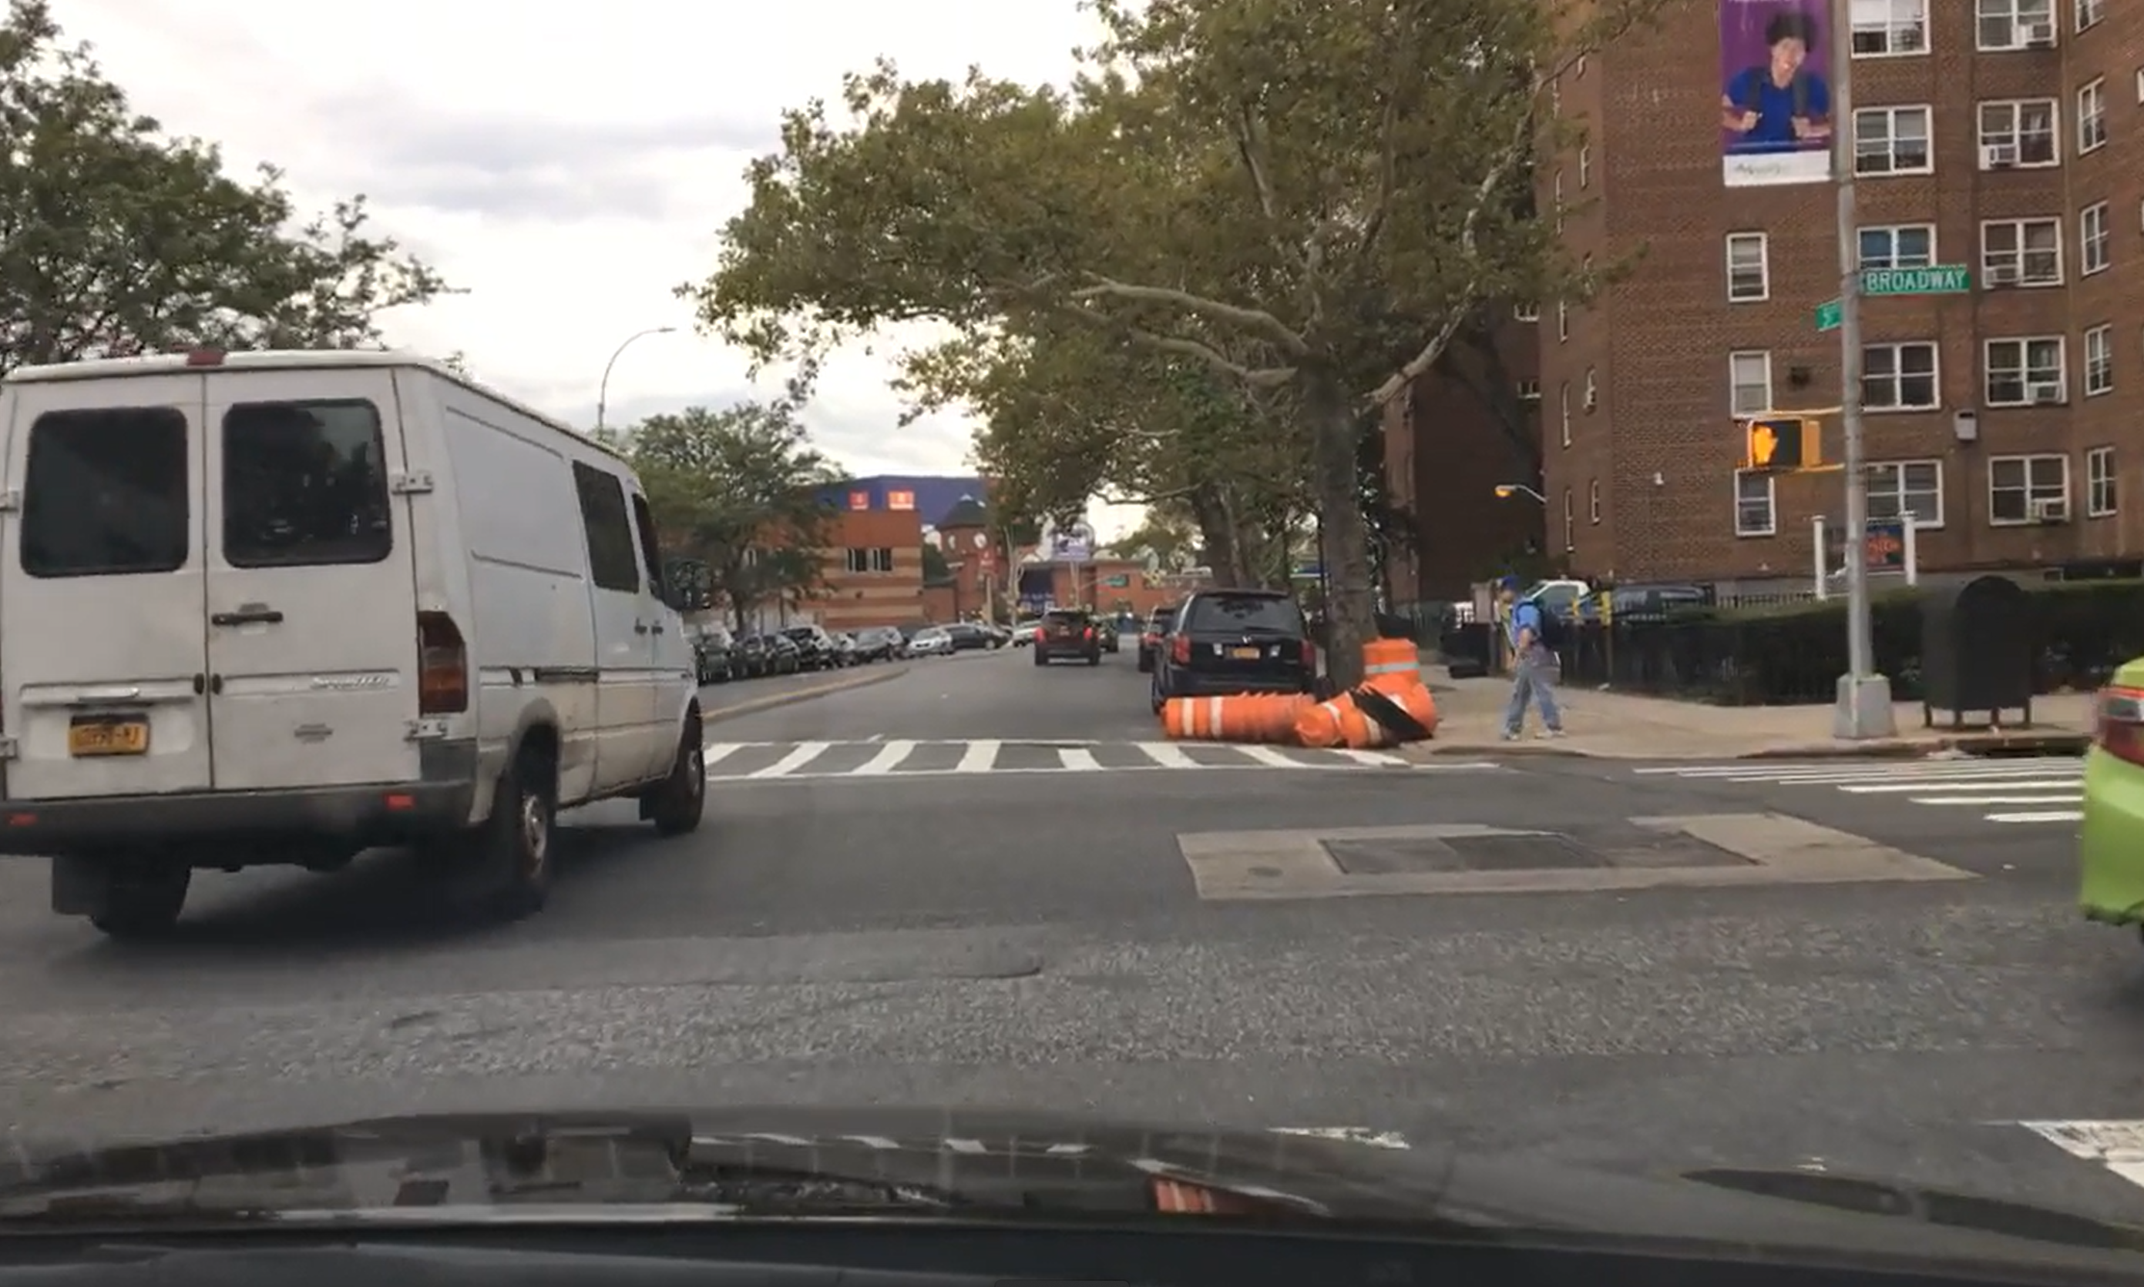
User study
Visionary Co-Driver
How do we evaluate the system in a Human-Computer Interaction Experiment?

Slide 30
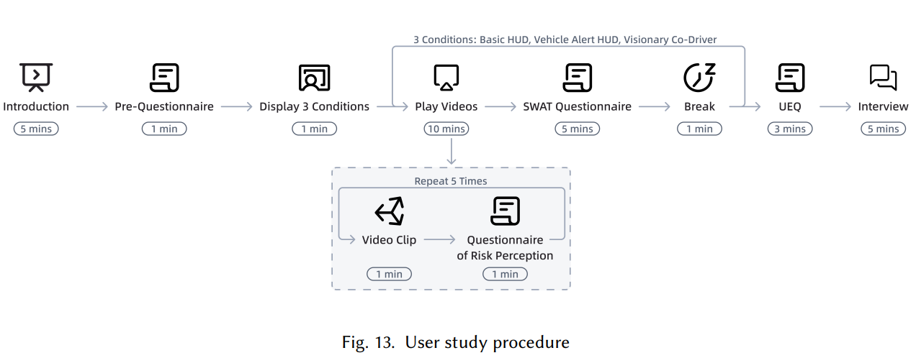
User Study Procedure (by my teammate)
Keywords: 非注意力盲视，分心，认知负荷，SWAT, UEQ
Visionary Co-Driver

Slide 31
Failure & success
Visionary Co-Driver
What did I learn from this summer research projects?

Slide 32

Failure Case 1 System Delay
Visionary Co-Driver
The connected model system is too slow.
Real time consideration is important,
But may be not so important
Solution:
Preprocessing for the ARHUD

Slide 33
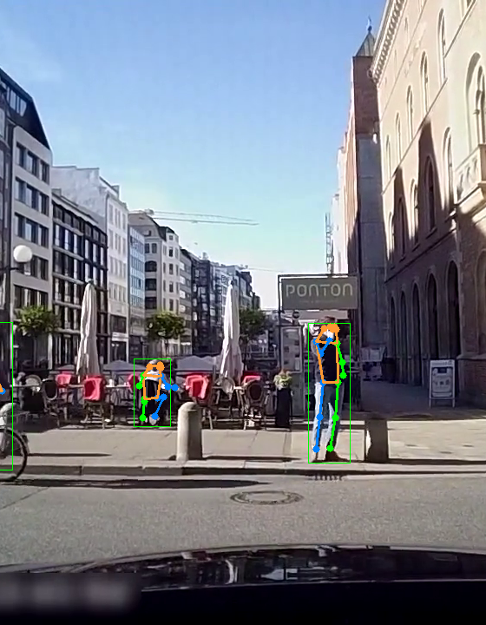
Failure Case 2 Pose Estimation
Visionary Co-Driver
- Intends to include pose direction for more detailed explanation and description.
- Analyzing pose bone is complex and challenging.
- May still need a neural network to determine the direction a person is facing.

Slide 34
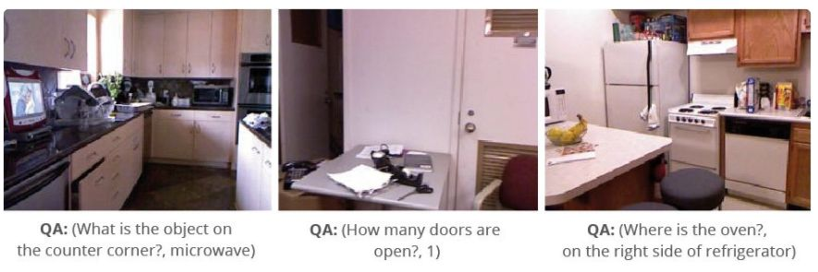
Failure Case 3: VQA(Visual Question Answering)
Visionary Co-Driver
Given a picture and text question(prompt), the model can give appropriate feed back
Natural approach of considering the vision2text task
however, it don’t work for now, too stupid. There is still not practical modal for common sense justification.

Slide 35
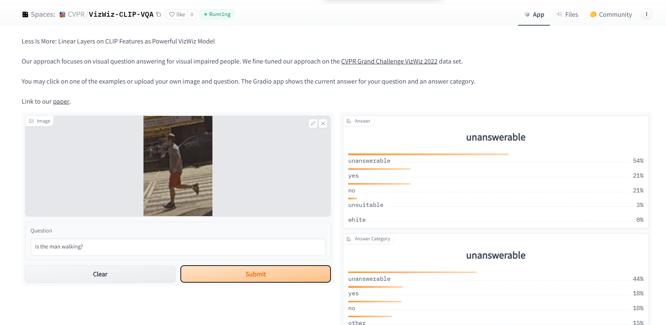
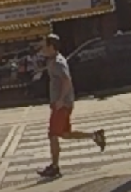
Failure Case 3: VQA(Visual Question Answering)
Visionary Co-Driver
Can’t recognize color the person is wearing
Can’t distinguish left and right
Can’t distinguish young or old
It is too unstable(50% success rate), so we don’t use it

Slide 36

Failure Case 4
Visionary Co-Driver
- Spent too much time on COT.
- As a big fan of AI agents such as Voyager and code-interpreter, devoted significant time to a major task.
- Possible disparity between personal desire and actual ability.
- Ambitious ideas necessitate a substantial team and extended time periods for success.

Slide 37
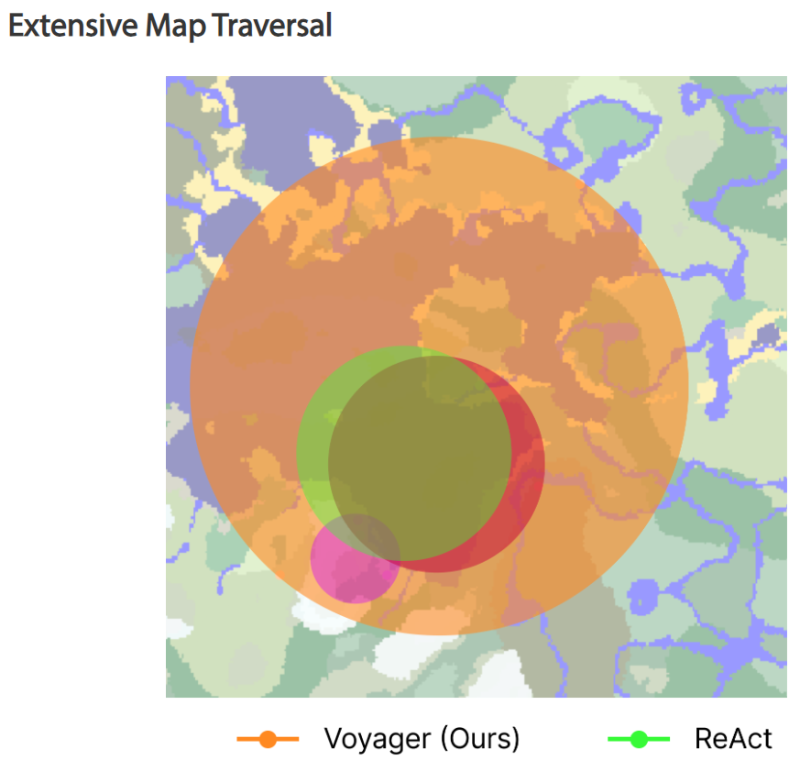
Possible IDEA: LLMs as Agent
Visionary Co-Driver
Intuition: Let GPT itself decide when to function call other api, obtain more information from the current screen.
Because
the VQA performance can be enhanced in Multiple Object scenario.
This sounds like a more ‘human-like’ behavior
Other Agent: Voyager, AutoGPT…

Slide 38

Blind, But Visionary Co-driver
Visionary Co-Driver
LLMs should actively call APIs, not just passively collect information.
They should probe conditions at upcoming intersections, acting as agents to perform analysis tasks.
This enables automated information collection and data analysis.
Suggested action includes writing an API segment to:
Extract interesting areas or boxes from an image.
Generate text from images.
Use Visual Question Answering (VQA) or call existing APIs to produce additional textual information.

Slide 39
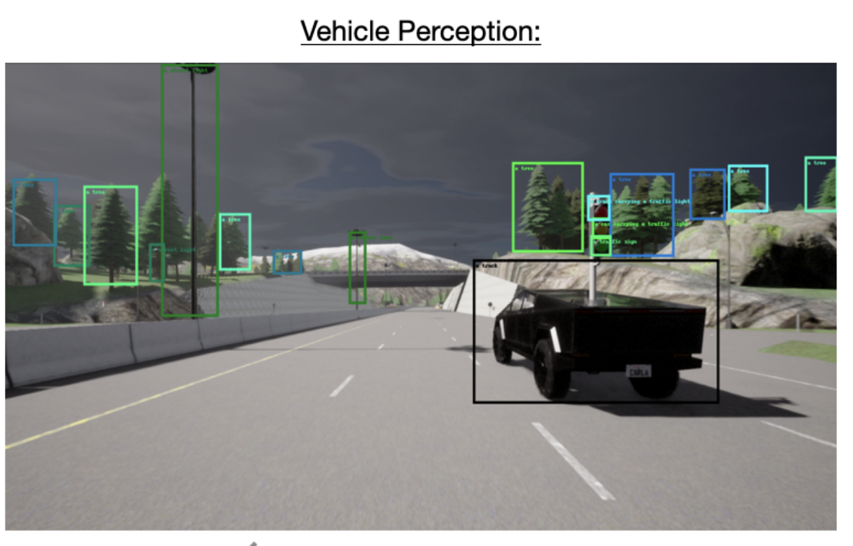
Why is our work more valuable even after visual GPT4 come out?
Visionary Co-Driver
Our Success
Vision involves inherent knowledge, and implicit reasoning.
Our approach has higher interpretability and requires less computational power
Prioritizing driving scenarios, breaking down scenes, and detailed descriptions all need further consideration.

Slide 40
The End
Visionary Co-Driver
That’s all, thank you for listening!

